Slide 1
Module 4
Blackbox Testing

Slide 2
Index
Blackbox testing
Equivalence class testing
Boundary value testing
Decision table testing
Pairwise testing
State transition testing
Use-case testing

Slide 3
Blackbox testing
Black Box Testing is a software testing method in which the functionalities of software applications are tested without having knowledge of internal code structure, implementation details and internal paths
Black Box Testing mainly focuses on input and output of software applications
It is entirely based on software requirements and specifications
It is also known as Behavioral Testing

Slide 4

The above Black-Box can be any software system you want to test or even your custom application
Under Black Box Testing, you can test these applications by just focusing on the inputs and outputs without knowing their internal code implementation.

Slide 5
How to do Blackbox testing
Here are the generic steps followed to carry out any type of Black Box Testing.
Initially, the requirements and specifications of the system are examined
Tester chooses valid inputs (positive test scenario) to check whether SUT (System Under Test) processes them correctly. Also, some invalid inputs (negative test scenario) are chosen to verify that the SUT is able to detect them
Tester determines expected outputs for all those inputs
Software tester constructs test cases with the selected inputs
The test cases are executed
Software tester compares the actual outputs with the expected outputs
Defects if any are fixed and re-tested

Slide 6
Types of Blackbox testing
There are many types of Black Box Testing but the following are the prominent ones :-
Functional testing - This black box testing type is related to the functional requirements of a system; it is done by software testers
Non-functional testing - This type of black box testing is not related to testing of specific functionality, but non-functional requirements such as performance, scalability, usability.
Regression testing - It is done after code fixes, upgrades or any other system maintenance to check the new code has not affected the existing code

Slide 7
Tools used for Blackbox testing
Tools used for Black box testing largely depends on the type of black box testing you are doing
For Functional/ Regression Tests you can use - QTP(Quick Test Professional), Selenium
For Non-Functional Tests, you can use - LoadRunner, Jmeter

Slide 8
Blackbox Testing Techniques
Equivalence class testing
Boundary value testing
Decision table testing
Pairwise testing
State transition testing
Use-case testing

Slide 9
Equivalence class testing
Equivalence Partitioning or Equivalence Class Partitioning is type of black box testing technique which can be applied to all levels of software testing like unit, integration, system, etc.
In this technique, input data units are divided into equivalent partitions that can be used to derive test cases which reduces time required for testing because of small number of test cases
It divides the input data of software into different equivalence data classes
You can apply this technique, where there is a range in the input field

Slide 10
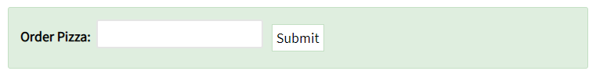
Example
Let's consider the behavior of Order Pizza Text Box Below
Pizza values 1 to 10 is considered valid. A success message is shown.
While value 11 to 99 are considered invalid for order and an error message will appear, "Only 10 Pizza can be ordered"

Slide 11
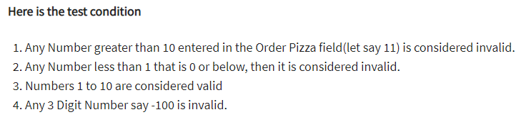
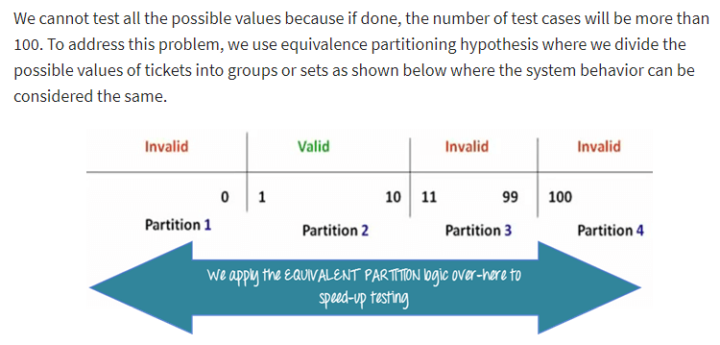

Slide 12
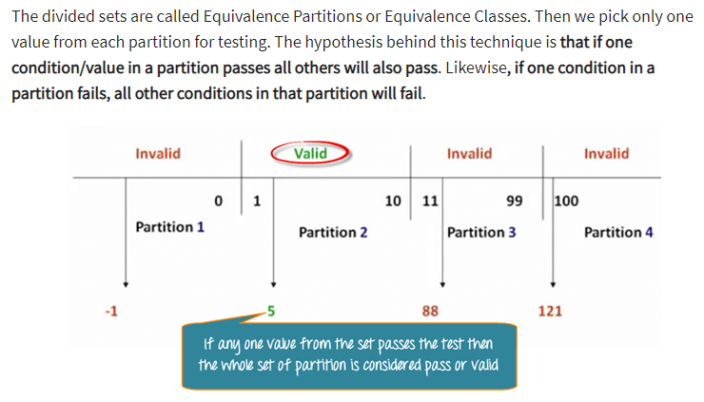

Slide 13
Boundary value testing
Boundary testing is the process of testing between extreme ends or boundaries between partitions of the input values
So these extreme ends like Start - End, Lower - Upper, Maximum -Minimum, Just Inside - Just Outside values are called boundary values and the testing is called "boundary testing“
In Boundary Testing, Equivalence Class Partitioning plays a good role
Boundary Testing comes after the Equivalence Class Partitioning

Slide 14
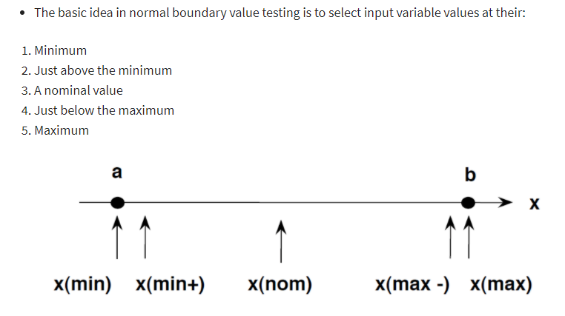

Slide 15
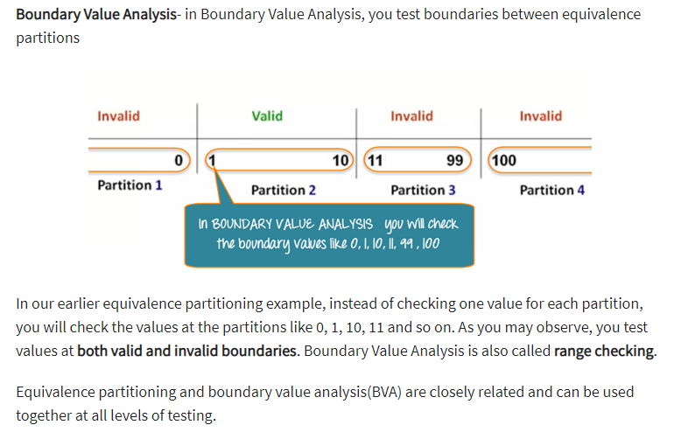
Example

Slide 16
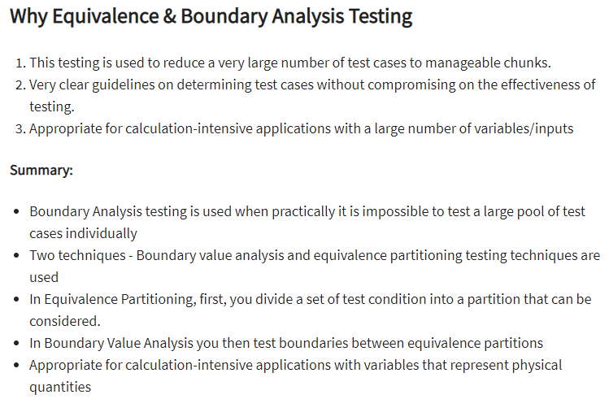

Slide 17
Decision table testing
A Decision Table is a tabular representation of inputs versus rules/cases/test conditions
It is a very effective tool used for both complex software testing and requirements management
Decision table helps to check all possible combinations of conditions for testing and testers can also identify missed conditions easily
The conditions are indicated as True(T) and False(F) values

Slide 18
Decision table testing is a software testing technique used to test system behavior for different input combinations
This is a systematic approach where the different input combinations and their corresponding system behavior (Output) are captured in a tabular form
That is why it is also called as a Cause-Effect table where Cause and effects are captured for better test coverage

Slide 19
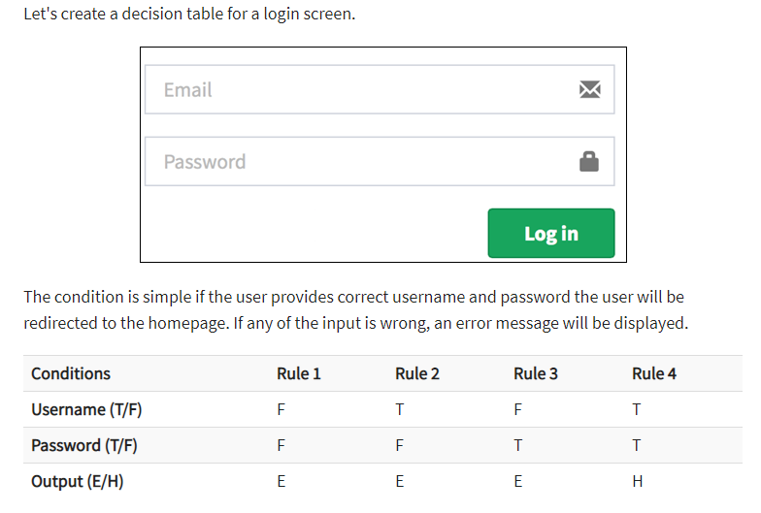
Example

Slide 20
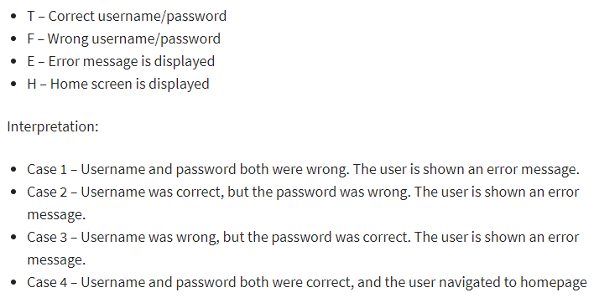

Slide 21
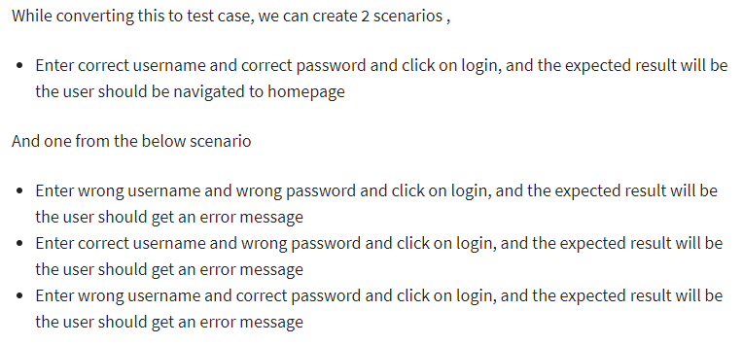

Slide 22
Why Decision Table Testing is Important?
Provides good coverage
Representation is simple so it is easy to interpret and use
Advantages of Decision Table Testing
Any complex business conditions can be easily turned into decision tables
In a case we are going for 100% coverage typically when the input combinations are low, this technique can ensure the coverage
Disadvantages of Decision Table Testing
When the number of input increases the table will become more complex

Slide 23
Pairwise testing
Pairwise Testing also known as All-pairs testing is a testing approach taken for testing the software using combinatorial method
It's a method to test all the possible discrete combinations of the parameters involved
Assume we have a piece of software to be tested which has got 10 input fields and 10 possible settings for each input field, then there are 10^10 possible inputs to be tested
In this case, exhaustive testing in impossible even if we wish to test all combinations

Slide 24
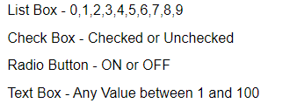
Example
An application with simple list box with 10 elements (Let's say 0,1,2,3,4,5,6,7,8,9) along with a checkbox, radio button, Text Box and OK Button
The Constraint for the Text box is it can accept values only between 1 and 100
Below are the values that each one of the GUI objects can take :

Slide 25
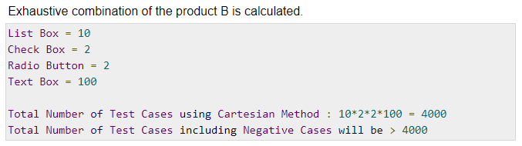

Slide 26
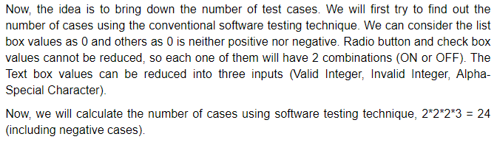

Slide 27
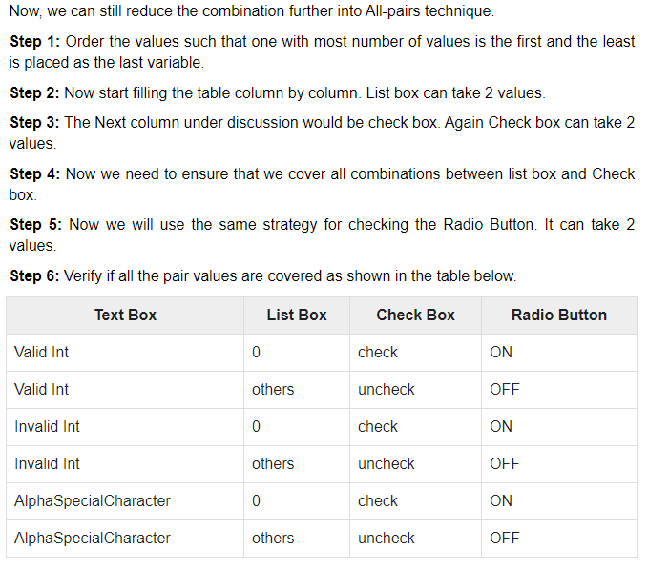

Slide 28
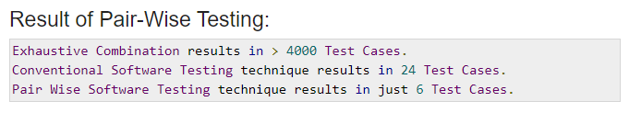

Slide 29
Advantages of Pairwise Testing
Pairwise testing reduces the number of execution of test cases
Pairwise testing increases the test coverage
Pairwise testing increases the defect detection ratio
Pairwise testing takes less time to complete the execution of the test suite
Pairwise testing reduces the overall testing budget for a project
Disadvantages of Pairwise Testing
Pairwise testing is not beneficial if the values of the variables are inappropriate
In pairwise testing it is possible to miss the highly probable combination while selecting the test data
Pairwise testing is not useful if combinations of variables are not understood correctly

Slide 30
State transition testing
State Transition Testing is a black box testing technique in which changes made in input conditions cause state changes or output changes in the Application under Test(AUT)
State transition testing helps to analyze behaviour of an application for different input conditions
Testers can provide positive and negative input test values and record the system behavior
State Transition Testing Technique is helpful where you need to test different system transitions.

Slide 31
When to Use State Transition?
This can be used when a tester is testing the application for a finite set of input values
When the tester is trying to test sequence of events that occur in the application under test
When to Not Rely On State Transition?
When the testing is not done for sequential input combinations
If the testing is to be done for different functionalities like exploratory testing

Slide 32
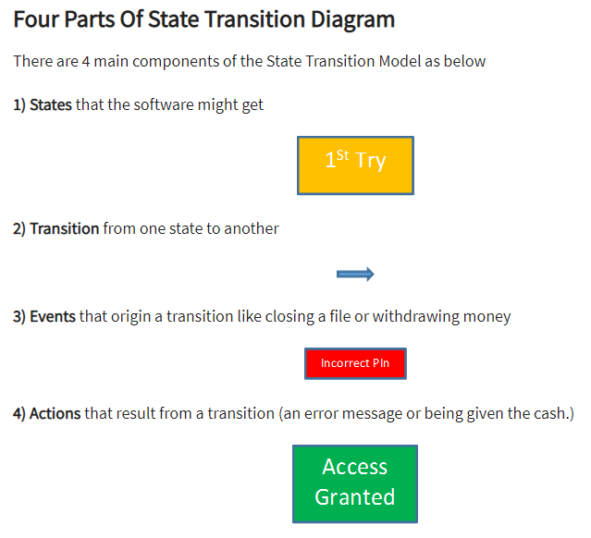

Slide 33
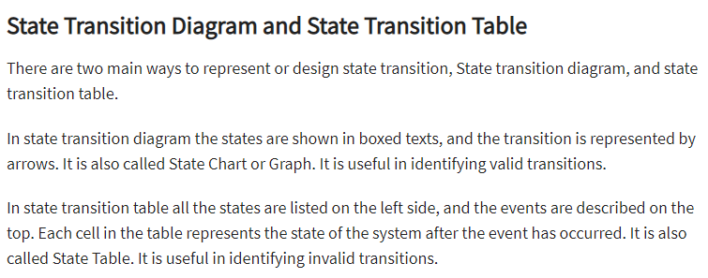

Slide 34
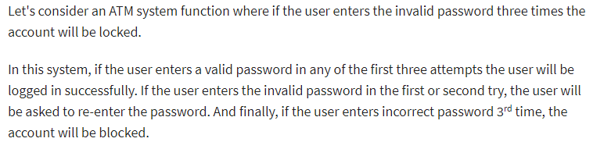
Example

Slide 35
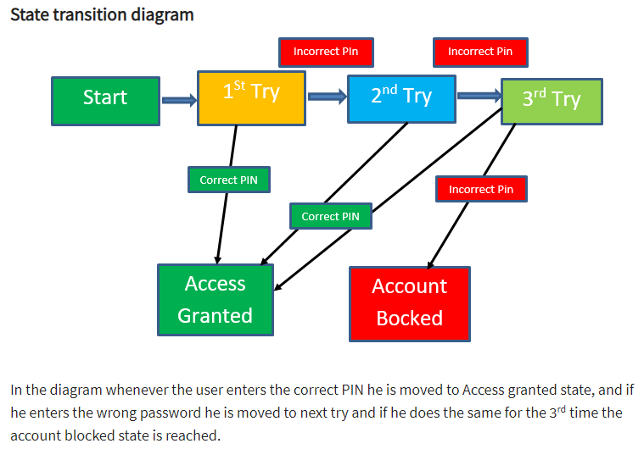

Slide 36
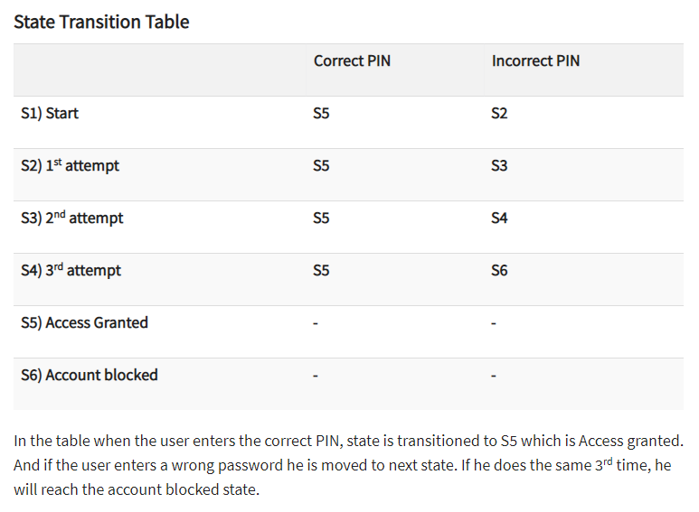

Slide 37
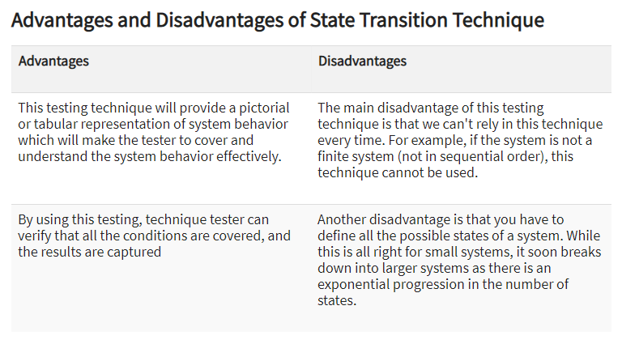

Slide 38
Use-case testing
A Use Case in Testing is a brief description of a particular use of the software application by an actor or user
Use cases are made on the basis of user actions and the response of the software application to those user actions
It is widely used in developing test cases at system or acceptance level

Slide 39
Use Case Testing is a software testing technique that helps to identify test cases that cover entire system on a transaction by transaction basis from start to end
Test cases are the interactions between users and software application
Use case testing helps to identify gaps in software application that might not be found by testing individual software components

Slide 40
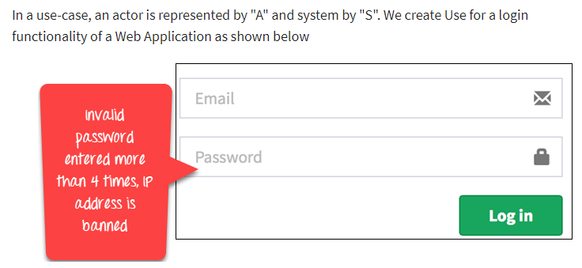
Example

Slide 41
